Slide 1
M Consulting Group
Wonderful Wines of the World

Slide 2
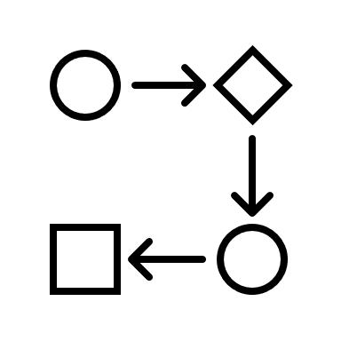
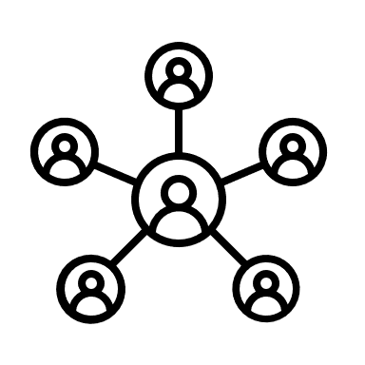



AGENDA.
CLUSTERING
Applying the models in order to segment the clients in useful clusters
01 BUSINESS UNDERSTANDING
03 CLUSTERING
05 BUSINESS RECOMENDATIONS
BUSINESS UNDERSTANDING
Understanding the main goal of the study
RECOMMENDATIONS
Useful suggestions for business and marketing recommendations
02 DATA PREPARATION
04 PROFILING
DATA PREPARATION
Understanding, exploring and preprocessing the data to perform the clustering
PROFILING
Defining and characterizing each cluster for the segments

Slide 3


BUSINESS UNDERSTANDING.
STEP 1
Understanding the business problem:
What are the buying behaviors and taste preferences of our customers?
Because we are running a clustering project for the purpose of a customer segmentation, the understandability and interpretability of the clusters will be paramount. This means that some of the analytical techniques (PCA, R-squared scores, etc.) will take a backseat to the business implications of our clusters.
Our clusters are only useful if they bring value to the business, so we will prioritize the business needs when making decisions like the variable selection and the number of clusters, over the pure computational results achieved.

Slide 4
DATA PREPARATION.
STEP 2
Preprocessing
0 duplicates
1 missing index label
60 outliers (.006% of the data)
Feature Engineering
logIncome, logLTV, RFM variables created
Feature Selection
By measuring the correlation of the available variables and how much information they each bring, we can select the variables that will give us the most relevant information for our business problem while minimizing redundancy.

Slide 5
CLUSTERING.
STEP 3
Our team used some of the best models out there to understand each segment of the customers, enabling WWW to optimize the effort in reaching their clients. Looking at the interaction of 3 behavior clusters and 3 wine preference clusters allowed us to isolate 4 customer segments.
Behaviors
Preferences

Slide 6

PROFILING.
STEP 4.1
Wine Preferences
Customer Value
Cluster Name
Most
Profitable
Dry Red
Dry White
Sweet Red
Sweet White
Dessert
Exotic
Web Purchases
Age
Income
Wolves of Wine Street
20%
64
103k
The Cabernet Club
49%
46
67k
The Pricetag Sommeliers
50%
31
45k
The Sour Shoppers
49%
40
57k
Least Profitable

Slide 7
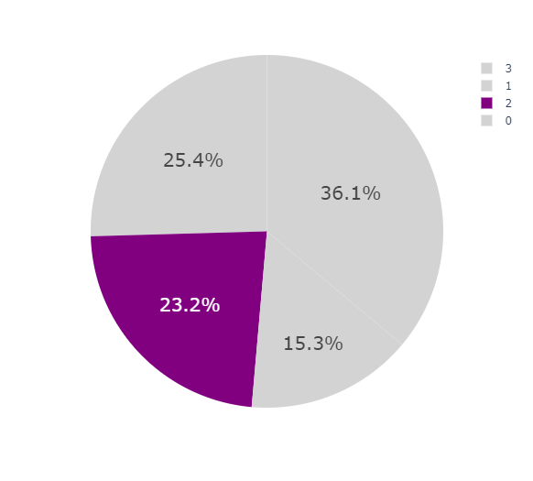
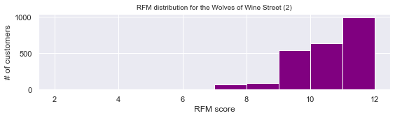
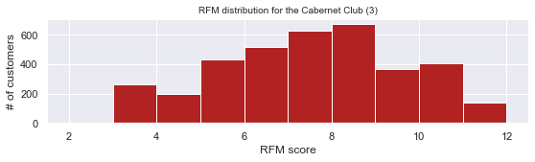
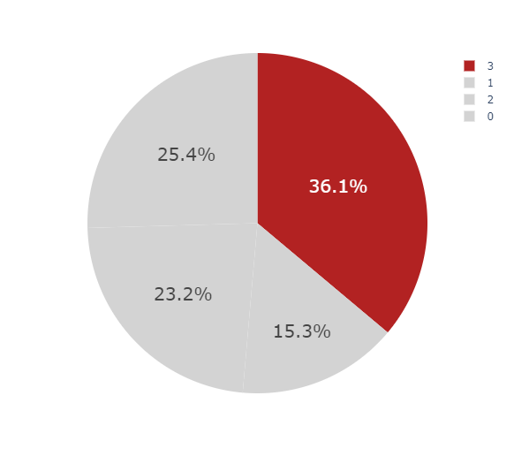
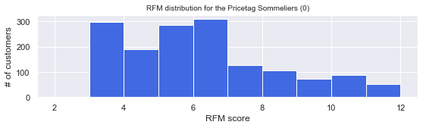
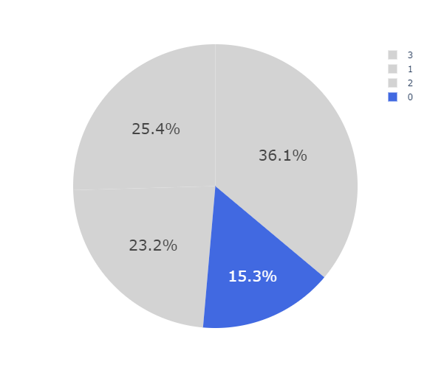
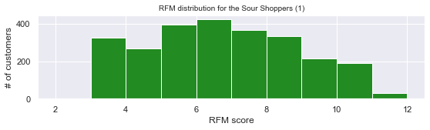
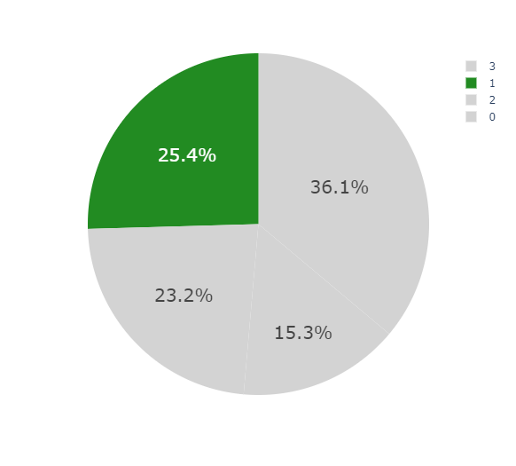
PROFILING: RFM.
STEP 4.2
Wolves of Wine Street
The Cabernet Club
The Pricetag Sommeliers
The Sour Shoppers

Slide 8






BUSINESS RECOMMENDATIONS.
STEP 5
Pricetag Sommeliers
MONTHLY WINE CLUB
Target the young, deal-oriented customers by offering monthly subscriptions where they can receive wine deliveries at home and exclusive deals/coupons. An automatic subscription will increase their frequency with passive purchases, and they will be attracted to the deals sent “just for them”.
Wolves of Wine Street
WINE+FOOD PAIRING EVENT (WITH A GUEST CHEF)
Running interesting events at your store locations are a great way to maintain customer engagement. The Wolves of Wine Street are your most valuable group, and are not interested in online deals but enjoy coming into the store.
Sour Shoppers
Cabernet Club
IF YOU LIKE THIS, TRY THAT
Offering specific deals for wines related to their preferences. For example a list of popular dry red and white wines for the Sour Shoppers, and a list of popular dry reds for the Cabernet Club, with an occasional exotic wine recommendation.

Slide 9
THANK YOU.
AND LET’S HAVE SOME WINE

